Slide 1

(Male, Bachelor) and (Female, Ph.D) have
different connotations:
Parallelly Annotated STylistic Language (PASTeL) Dataset with Multiple Personas
Dongyeop Kang, Varun Gangal and Eduard Hovy Carnegie Mellon University
Notes:
15m / 3m

Slide 2

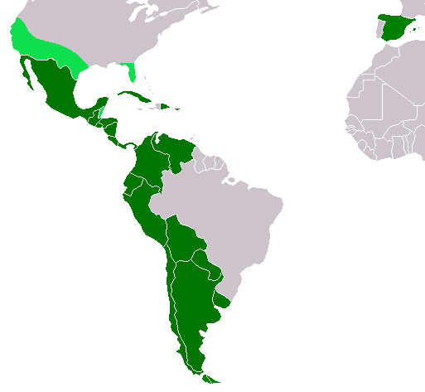
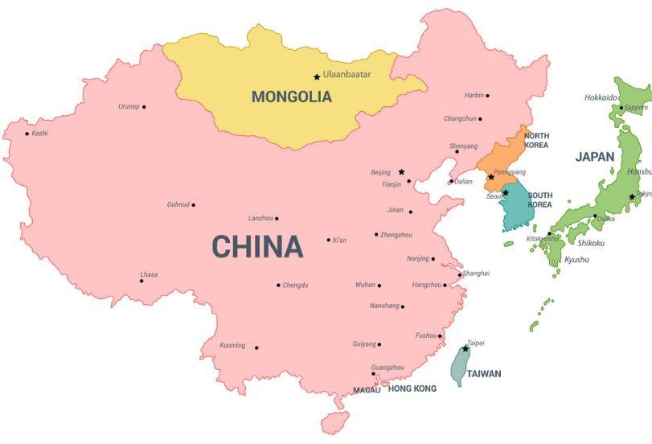
Textual Variation with Persona
Do highly educated people write longer sentences (Bloomfield, 27)?
Are Hispanic & East Asian people more likely to drop pronouns (White, 85) ?
Are elder people likely to use lesser anaphora (Ulatowska et al., 86) ?
Notes:
In writing or speech, the deliberate repetition of the first part of the sentence in order to achieve an artistic effect is known as Anaphora.
“Every day, every night, in every way, I am getting better and better.”

Slide 3
Stylistic Variation in Text
Stylistic variation in text primarily manifest themselves at the different levels of textual features (e.g., lexical, syntactic) (DiMarco & Hirst, 90)
Connecting such features to someone’s persona is important to understand stylistic variation of language.
Notes:
(e.g., word choice) (e.g., preference for the passive voice)
Lexical + syntactic features, pragmatics (e.g., cultural), and more

Slide 4
Pop Quiz
Examples from the PASTeL dataset
Context:
went to an art museum with a group of friends.
Education: HighSchool
Education: Bachelor
Ex1: My friends and I went to a art museum yesterday.
HighSchool
Ex2: I went to the museum with a bunch of friends.
Bachelor
Notes:
Guess education level of writer of the examples text.
I’m not a native speaker, so you guys tell me why?

Slide 5
Pop Quiz (2)
Examples from the PASTeL dataset
Context:
the living room of our new home is nice
and bright with natural light.
Education: NoDegree
Education: Graduate
Gender: Male
Gender: Female
Ex: The house tour began in the living room which had a sufficient amount of natural lighting.
Graduate
Female
Caucasian
RightWing
Notes:
Guess education level of writer of the examples text.

Slide 6
Overview
Collect stylistic text written in parallel from people with different personas
(1) directly ask writers’ personas (e.g., age, gender, ethnicity..)
(2) fix the context (denotation) & collect stylistically diverse text (connotations) by asking them to describe it by their own language.
Applications using the PASTeL dataset
“Controlled” style classification
(optional) “Supervised” style transfer
Notes:
Let them describe the context with their own language

Slide 7
Challenges for Collecting Style Language Dataset
(1) Too broad categories of styles and lack of its definition
(2) Styles in conjunction and their dependency
(3) Lack of parallel causes semantic drift

Slide 8
Different Definitions of Style in Language
Appropriately varying the style of text often conveys more info. than is contained in the literal meaning (Hovy, 87)
Pragmatics aspects (e.g., relation) & Rhetorical goals (e.g., formality)
A strategic choice of language in social interaction (Hovy, 18)
Category of participants’ characteristics (Biber, 91)
Participants’ roles & relations & group characteristics (e.g., social class)
Creative language
Sentiment, humor, emotion, and more (Ji & Knight 18)
Notes:
high-level facets and low level words/characters Formal facet
Functionalize the low-level decision
Looking at every facets/aspects of styles is impossible. One can’t build such system G.

Slide 9
Categories of Style Language
Pragmatics styles
Interpersonal / Relationships:
formality, politeness, …
Group characteristics:
age, gender, political orientation, education level, ethnic, country, …
Affective styles:
emotion, romance offense, …
Figurative styles:
Humor, sarcasm, metaphor, …
….
Focus on one specific aspect of style, pragmatics aspects in group characteristics of speakers, which is also called persona.
Notes:
E.g., emotions and politeness are somewhat related.
Definition
Conjunctionism:
Parallelism & Denotation

Slide 10
Challenges for Collecting Style Language Dataset
(1) Too broad categories of styles and lack of its definition
(2) Styles in conjunction and their dependency
(3) Lack of parallel text causes semantic drift

Slide 11
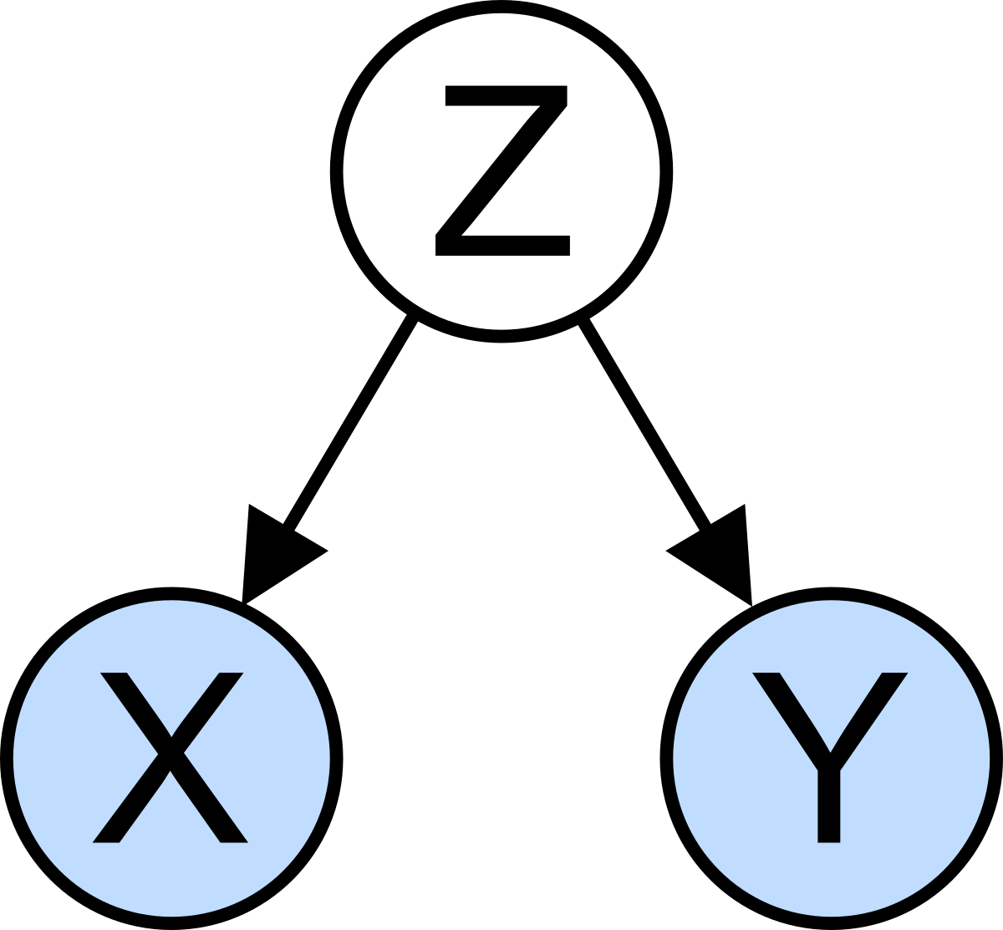

Text varies by multiple styles in conjunction.
When transferring/classifying single style of text, other confounding style variables need to be controlled.
Gender-controlled social network analysis (Bamman et al., 15; Nguyen et al., 16)
(Gender,Age)-controlled personalized machine translation (Rabinovich et al., 17)
Male
Female
25-44
55<=
...
...
...
...
Notes:
1. Known correlations between stylistic and demographic features
Computational Sociolinguistics: A Survey, https://www.aclweb.org/anthology/J16-3007/
(Only for gender and other features) Gender identity and lexical variation in social media, https://onlinelibrary.wiley.com/doi/full/10.1111/josl.12080
Carolyn / David and Lori will teach sociolinguistics in their course, Human Languages for AI, probably next month.
2. Utterances of politicians with age & gender information (dataset) http://cl.haifa.ac.il/projects/pmt/
For your second project, this dataset may be useful to control age & gender and observe correlations of other factors.
When I went to COLING last year, some people looked very angry in front of a poster about an automatic personal info prediction which claims African people tend to use some styles, etc. Be careful that some people are incredibly sensitive to this kind of study...

Slide 12
Styles in conjunction and their dependency
Collect six types of group characteristics in conjunction.
Country
USA, UK
Age
<12, 12-17, 18-24, 25-34, 35-44, 45-54, 55-74, >=75
Education Level
Associate, TechTraining, NoSchool, HighSchool/NoDiploma, Bacherlor, Master, Doctorate, NoDegree, HighSchool
Ethnicity
Caucasian, Hispanic/Latino, MiddleEastern, SouthAsian, NativeAmerican, Pacific- Islander, CentralAsian, African, EastAsian, Other
Gender
Femail, Male,
Non-Binary/Third-Gender
Political View
Centrist, LeftWing, RightWing
Notes:
Vocational education is education that prepares people to work as a technician or in various jobs such as a trade or a craft. Vocational education is sometimes referred to as career and technical education. A vocational school is a type of educational institution specifically designed to provide vocational education. Wikipedia
E.g., emotions and politeness are somewhat related.
Definition
Conjunctionism:
Parallelism & Denotation

Slide 13
Challenges for Collecting Style Language Dataset
(1) Too broad categories of styles and lack of its definition
(2) Styles in conjunction and their dependency
(3) Lack of parallel text causes semantic drift
When transfering one style to another, the output meaning can drift away from the original one called semantic drift.
Without parallel text, it’s difficult to develop a system that can appropriately learn stylistic variation and even evaluate it.
“Unsupervised” vs “Supervised” style transfer
Notes:
Some unsupervised models tackle the issues: VAE, cyclic loss, etc.

Slide 14
Fix the meaning and collect different styles of text
Context
Context
Fix the denotation and then parallely collect connotations
from people with different personas.

Slide 15
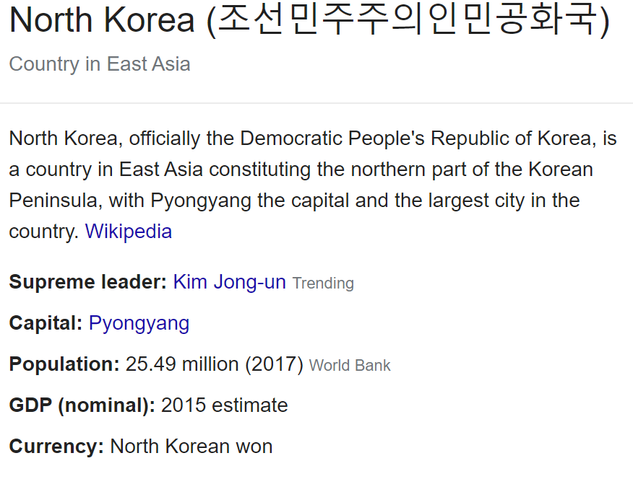
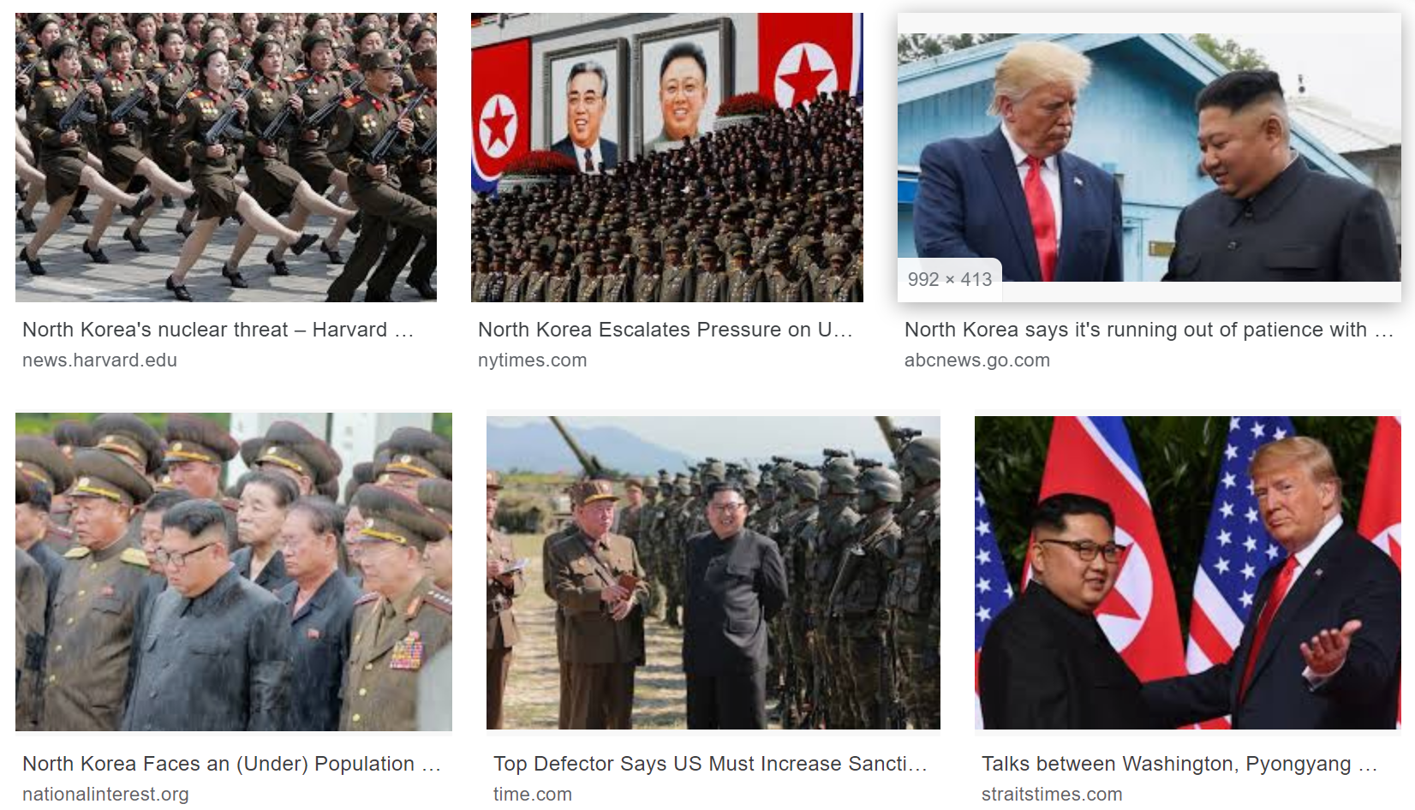
Denotation
What is meaning of “North Korea” ?
https://en.wikipedia.org/wiki/North_Korea
google.com/search?q=north+korea
Denotation: Literal, explicit, and factual meaning of a thing
Notes:
Denotation of a word/image conveys information.
Dictionary deinition.

Slide 16

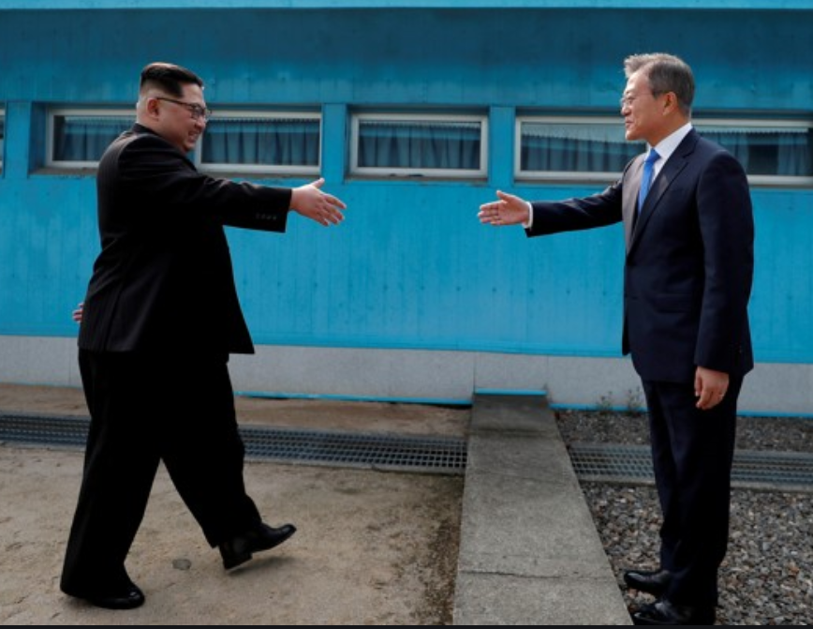
Connotations
What is meaning of “North Korea” ?
Person 1
Person 2
= { Age : 45-55 ,
Race : Caucasian,
Political view : Right,
Education : Ph.D. , … }
= { Age : 25-34 ,
Race : Asian,
Political view : Left ,
Education : NoDegree , … }
Connotation: Figurative and implicit meaning
Subjective meanings by personal/cultural/social context
Notes:
Emotional / imaginative associations
Connotations of word/image create connections
May depend on personl context, cultural (pragramatics) context, social mindsets of the time.

Slide 17
Fix Denotation, Parallelly Collect Connotations
Which denotation?
Denotation
C1
C2
C3
C4
P1
P2
P3
P4
People have their own persona, and they are implicitly reflected in their connotations.
Notes:
This will happen in text as well. Let’s look at this in more general setting.
Whatever you write something, your persona will be reflected in your text.
People often ignore the P part.
We can’t build the exact G system for individual person unfortunately, so guessing or approximating G given D, P, and C.

Slide 18

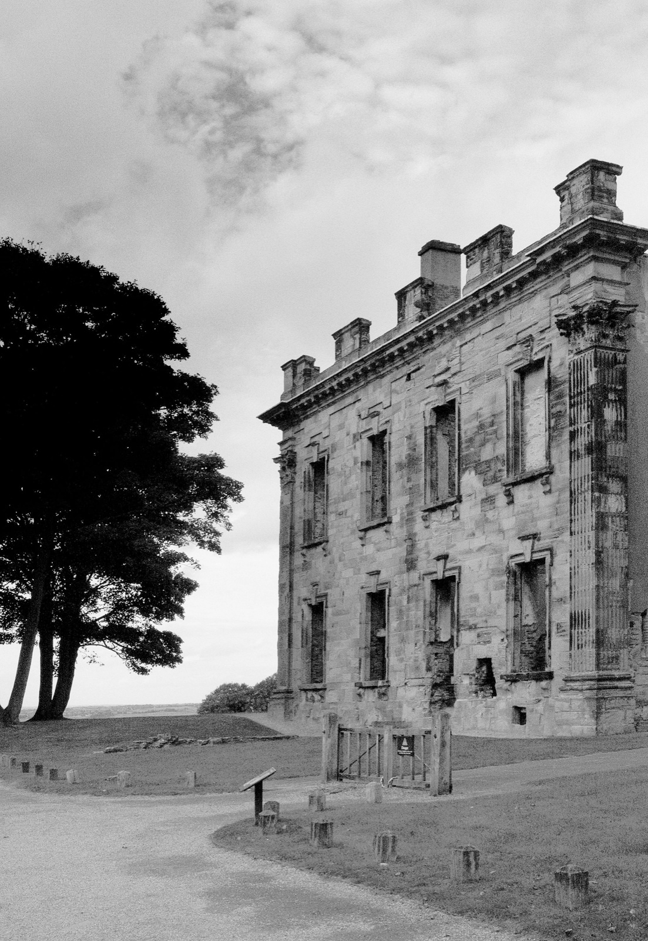
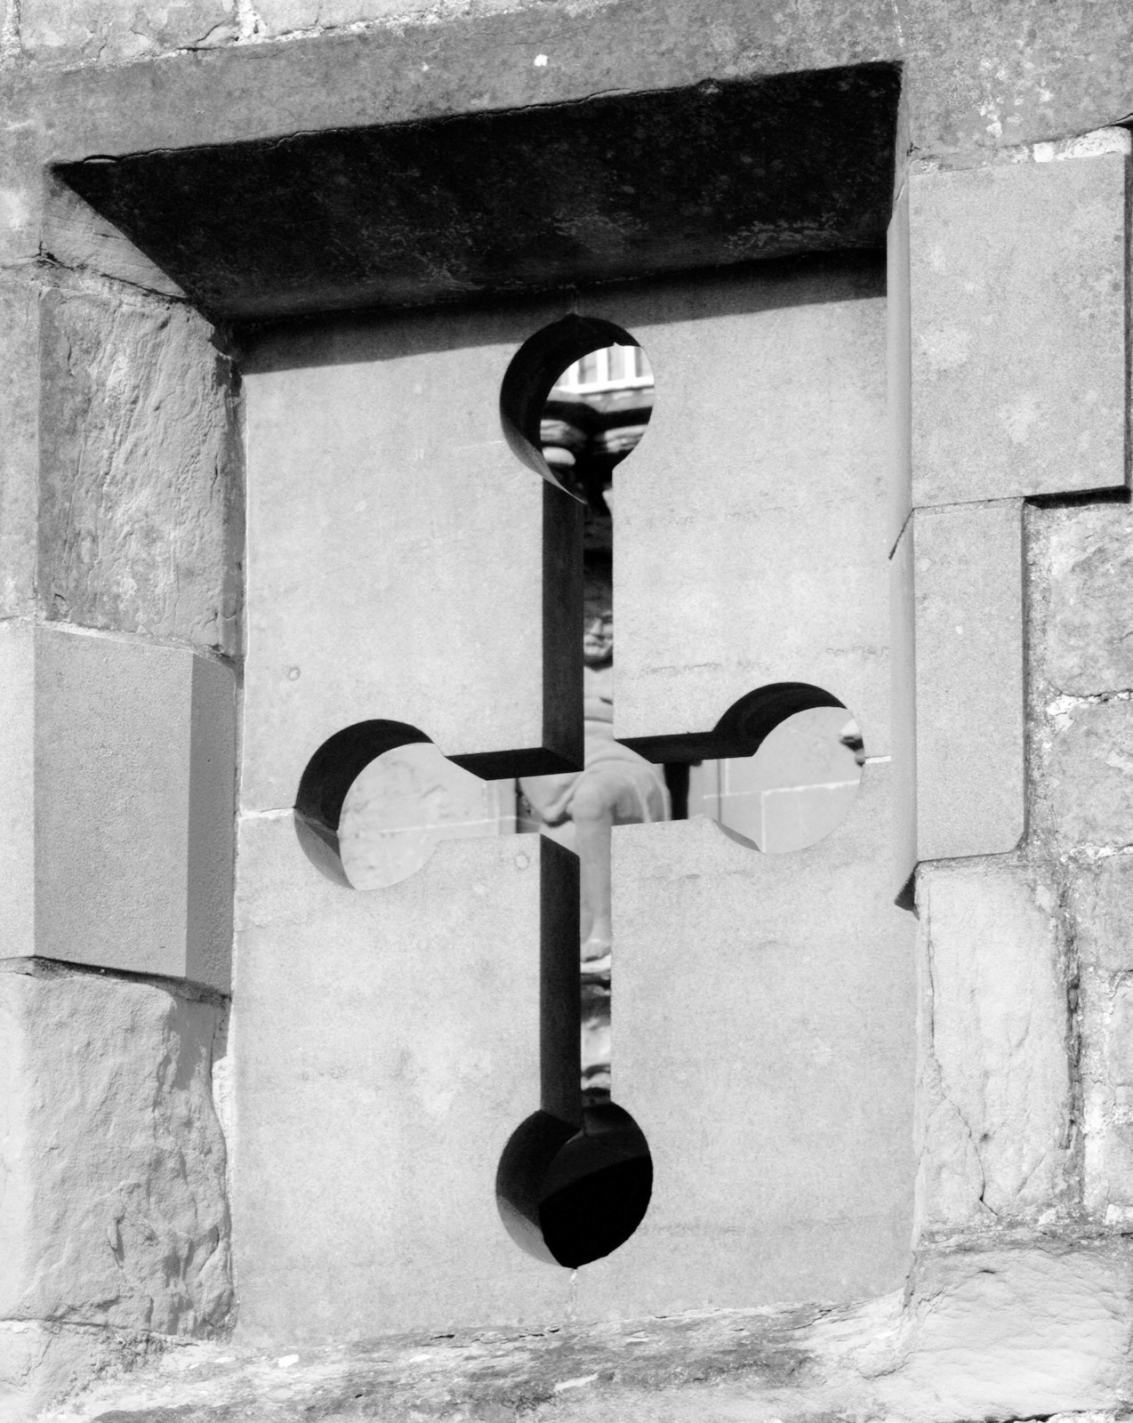
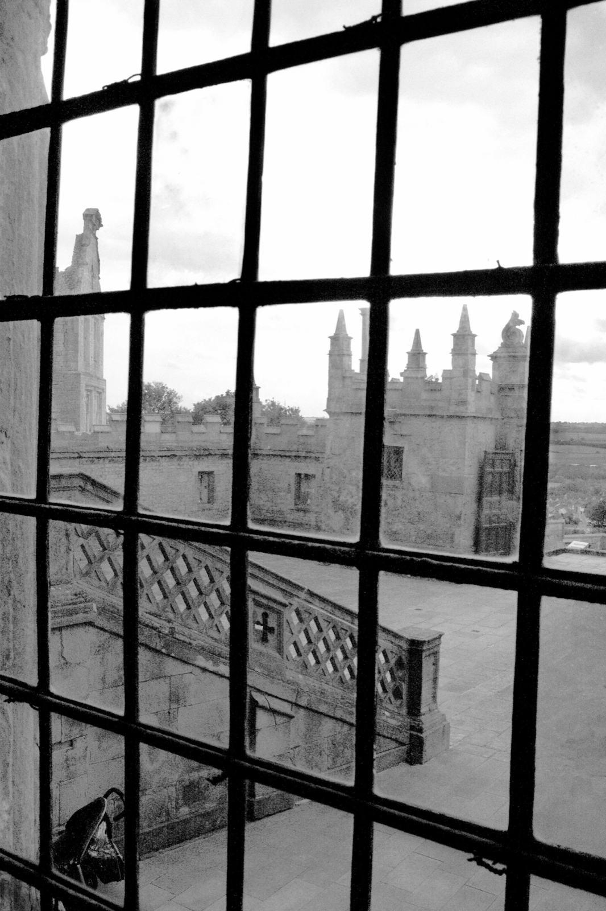
Which Denotation Setting?
Case study on denotation setting
the old wooden door was only one way into the courtyard.
wooden, door, courtyard
Text
Image w/keywords
wooden, door, courtyard
Image
Story( Images w/keywords)
Notes:
More context from visual modality
Partial information

Slide 19
Which Denotation Setting? Text
Case study on denotation setting
the old wooden door was only one way into the courtyard.
Repeat the input text with a little changes of the lexical terms.
Mostly preserves the meaning by simple paraphrasing, but their personal style does not reflect the variation.
The old door with wood was the only direction to the courtyard
Meaning preservation
✅
Style diversity
❌
Notes:
Workers mostly repeat the input text with a little changes of the lexical terms.
Mostly preserves the meaning by simply paraphrasing the sentence, but their personal style does not reflect the variation.

Slide 20
Which Denotation Setting? Images / Story(Images)
Case study on denotation setting
Outputs from single image tend to be diverse, but too divergent (i.e. meaning drift)
A series of consistent images (i.e., a story) helps narrowing down the diversity by grounding it to a specific event.
The old wooden door in the stonewall looks like a portal to a fairy tale.
Meaning preservation
🔺
Style diversity
✅
Stories with images/text from Visual StoryTelling (ViST) dataset (Huang et al, 16).
Notes:
Workers mostly repeat the input text with a little changes of the lexical terms.
Mostly preserves the meaning by simply paraphrasing the sentence, but their personal style does not reflect the variation.

Slide 21
Which Denotation Setting? Story(Imgs+Keywrds)
Case study on denotation setting
Some keywords help deliver more concrete meaning of content as well as the style diversity.
wooden, door, courtyard
Equally so, he is intrigued by the heavy wooden door in the courtyard.
Meaning preservation
✅
Style diversity
✅
Keywords are extracted using RAKE (Rose et al, 10)
Notes:
Workers mostly repeat the input text with a little changes of the lexical terms.
Mostly preserves the meaning by simply paraphrasing the sentence, but their personal style does not reflect the variation.

Slide 22
Fix Denotation, Parallelly Collect Connotations
More quantitative analysis on denotation experiment
Meaning
preservation
Semantic similarity of the output with the reference
- METEOR (Banerjee & Lavie, 05)
- VectorExtrema (Liu et al., 16)
Denotation
C1
C2
C3
C4
Style diversity
How much outputs lexically differ amongst themselves
- Gaussian-mixture entropy of N-gram
P1
P2
P3
P4
Notes:
Fix the denotation and then parallely collect connotations
from people with different personas.
Crowd-workers
NOTE: we don’t intend to test your literary OR writing skills here. Rather, we’re really interested in how you would write the story in your own style/persona.

Slide 23
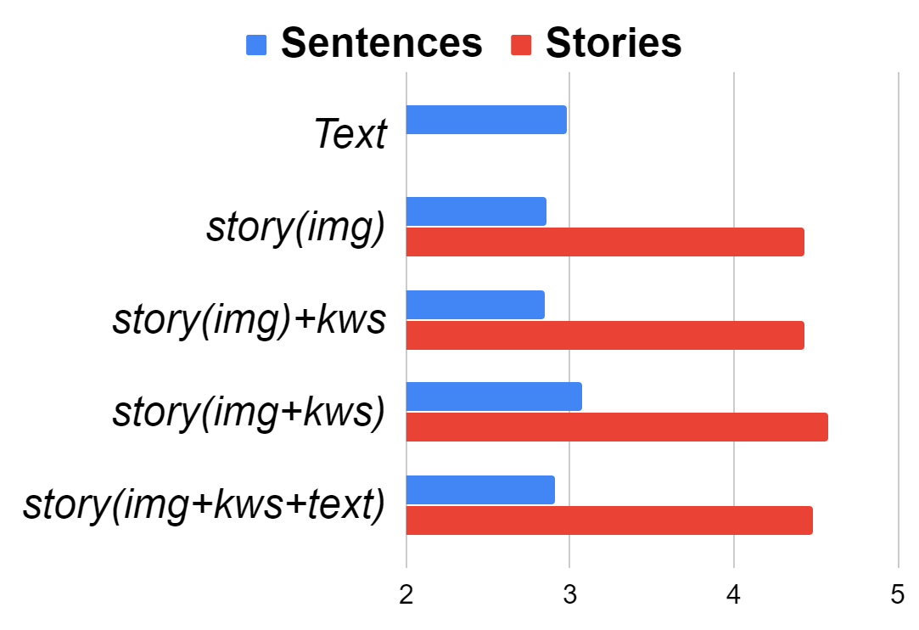
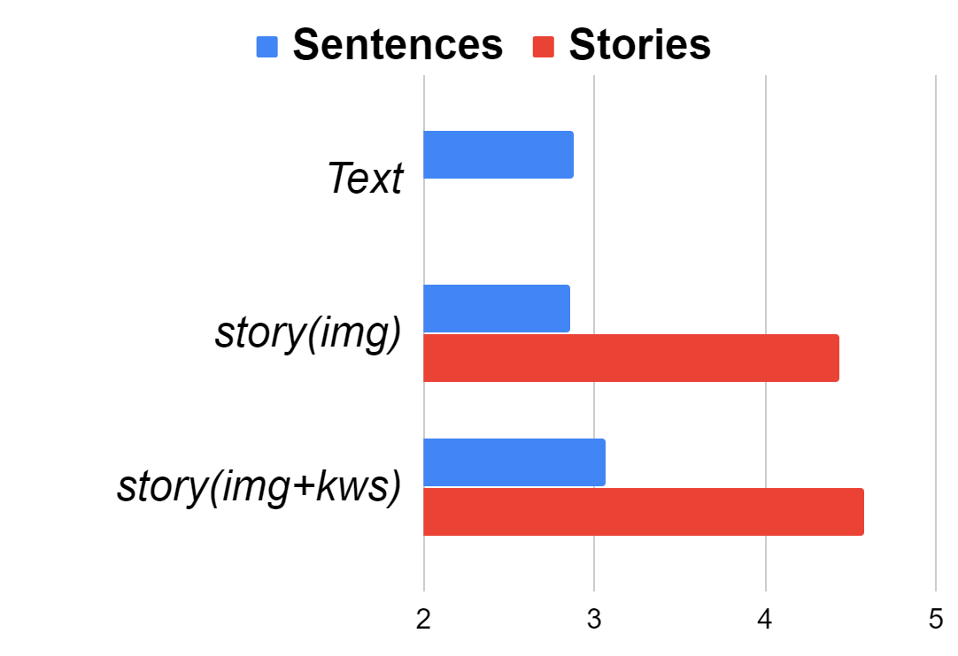
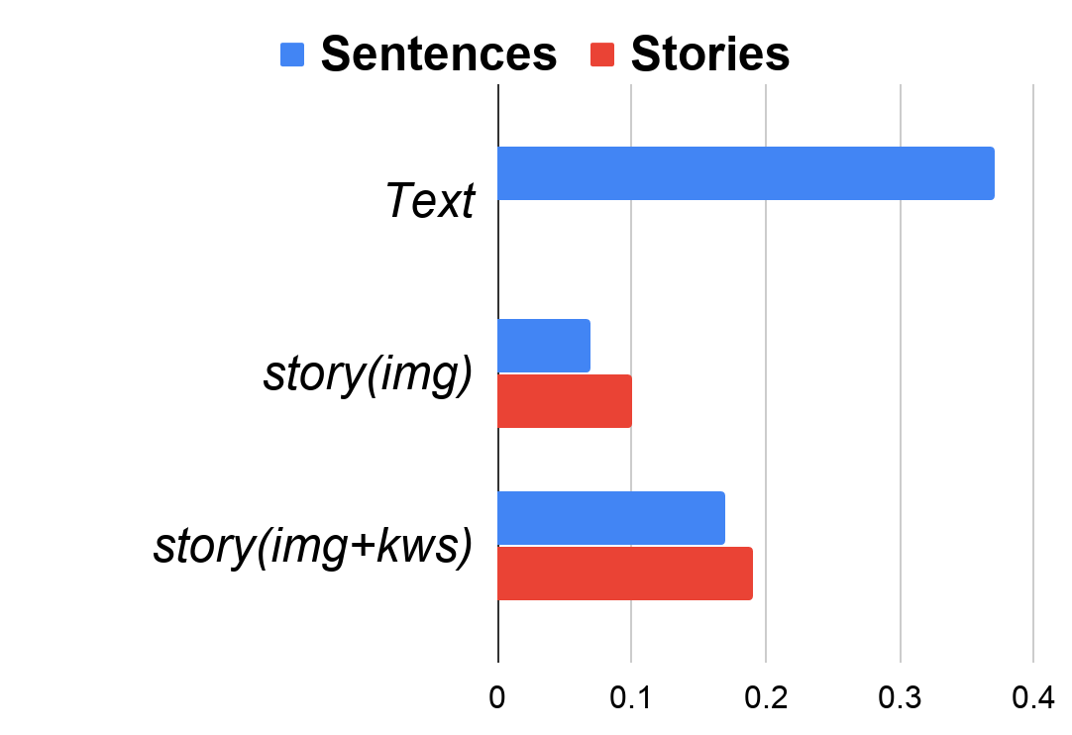
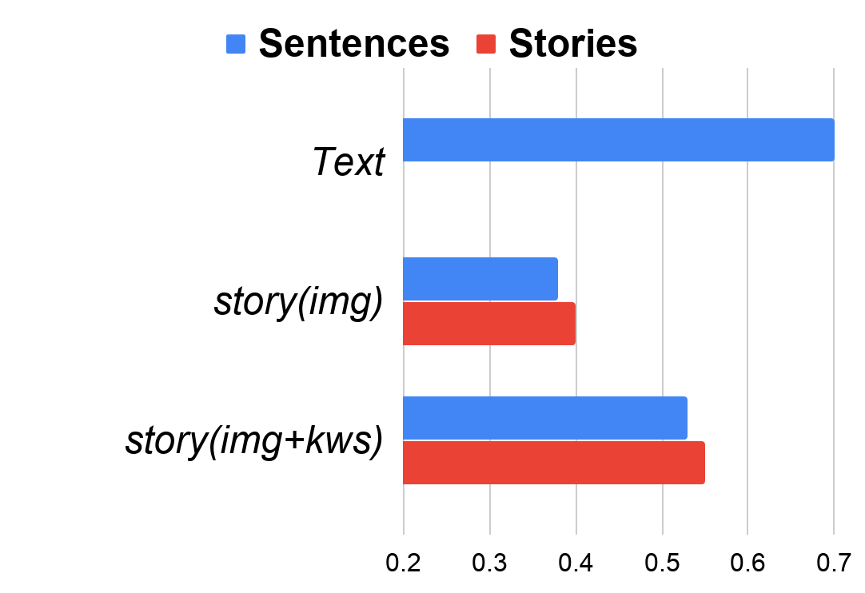
Which Denotation Setting?
More quantitative analysis on denotation experiment
Style Diversity
Meaning preservation
GM (ngram entropy)
METEOR
VectorExtreme
Text
Story(Images)
Story(Images
w/keywords)

Slide 24
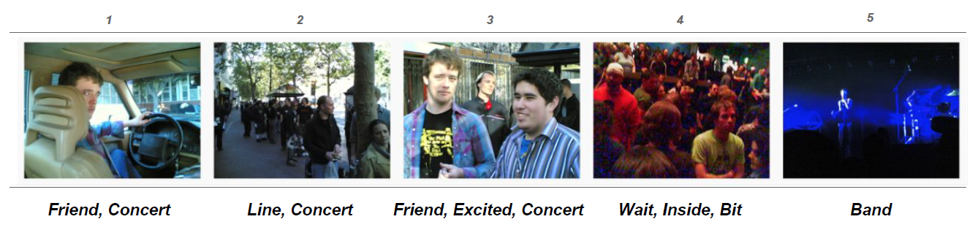
Which Denotation Setting? Story(Imgs+Keywrds)
More quantitative analysis on denotation experiment

Slide 25
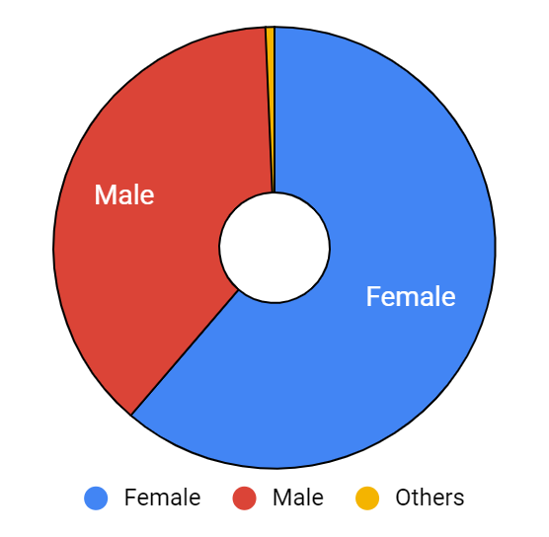
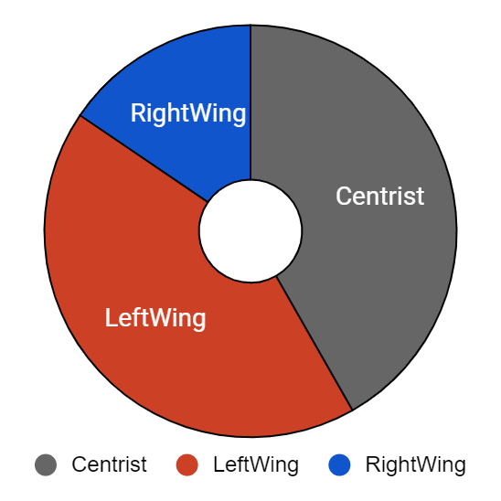
PASTeL Dataset
41,550 sentences and 8,310 stories (1 story~5 sentences)
Restricted to be from USA or UK
The avg number of HIT per annotator: 9.97
Filtered 4.6% of noisy output text
Gender
Political view
Notes:
The number of unique workers participated: 501

Slide 26
Overview
Collect stylistic text written in parallel from people with different personas
(1) directly ask writers’ personas (e.g., age, gender, ethnicity..)
(2) fix the context (denotation) & collect stylistically diverse text (connotations) by asking them to describe it by their own language.
Applications using the PASTeL dataset
“Controlled” style classification
(optional) “Supervised” style transfer

Slide 27
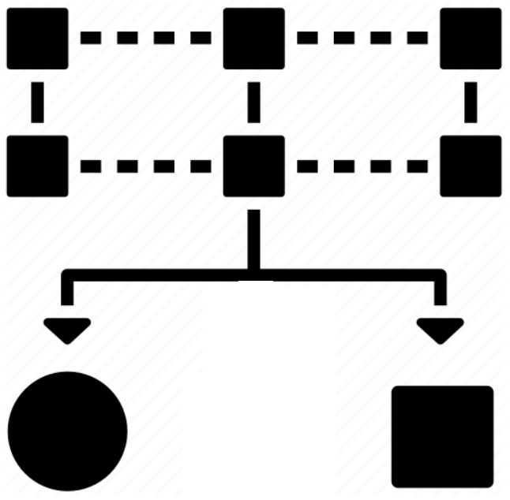
“Combined” Style Classification
Restrict to binary classification on two most frequent categories of four styles: [Age, Politics, Education, Gender]
Target style: Gender (2)
Categories: Male, Female
*No external styles to be controlled
Male
Female
...
...
Binary classifier

Slide 28
“Controlled” Style Classification
Restrict to binary classification on two most frequent categories of four styles: [Age, Politics, Education, Gender]
Target style: Gender (2)
Categories: Male, Female
*External styles to be controlled:
- Age(2), Education(2), Politics(2)
Male
Female
18-34
Bachelor
LeftWing
Binary classifier (1)
2 x 2 x 2 = 8
combinations
of the controlled variables
35-44
Bachelor
LeftWing
Binary classifier (2)
...
...
...
...
35-44
NoDegree
RightWing
Binary classifier (8)
No shared representation.
No multi-task learning setup.

Slide 29
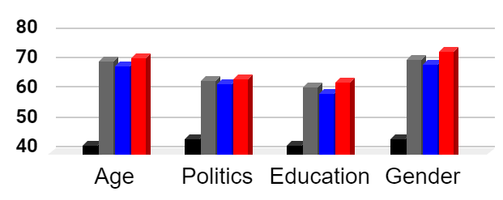
“Controlled” Style Classification
Target style: Age (2), Political View (2), Education level (2), Gender (2)
Features: lexical (ngram, #-entities, #-stopwords), syntax (sent-len, #-POS, #-oov), semantic (senti), deep (BERT)
Majority
Deep Avg Net (Iyyer et al., 15)
(only deep features)
Combined
Controlled
accuracy
Notes:
(1) controlled is more effective than combined. Outperforms the other baselines. -> importance of controlling the confounding variables.
(2) gender/age are easier to predict than political view and education level from text.

Slide 30
“Controlled” Style Classification
Target style: Age (2), Political View (2), Education level (2), Gender (2)
Features: lexical (ngram, #-entities, #-stopwords), syntax (sent-len, #-each-POS, #-oov), semantic (senti)
Model: Logistic regression classifier
PROPN, ADJ, #-ENTITIES, went, party, SENT-LEN
happy, day, end, group, just,
snow, NOUN
Male
Female
female, time, NOUN, ADP, VERB, porch, day, loved
SENT-LEN,
PROPN, #-ENTITIES,
n’t, ADJ, NUM
LeftWing
RightWing
Notes:
Lexical choices (which are content words)

Slide 31
Conclusion & Future Directions
PASTeL dataset
A parallelly written text across different personas.
More valid setup for “controlled” style classification and “supervised” style transfer in the model design as well as evaluation.
Some lessons and future directions
Exactly know what type of styles you are working on.
E.g., Persona: pragmatics aspect of group characteristics
Style is not always separable from content
E.g., word ‘happy’ for Female, word ‘time‘ for LeftWing
Notes:
Content-style relationship/dependency
Personalized machine translation (Rabinovich et al., 17)
Cross-style classification/transfer
with shared representation across multiple styles
More in-depth analysis on style-persona relationship (Preoţiuc-Pietro & Ungar, 18)

Slide 32
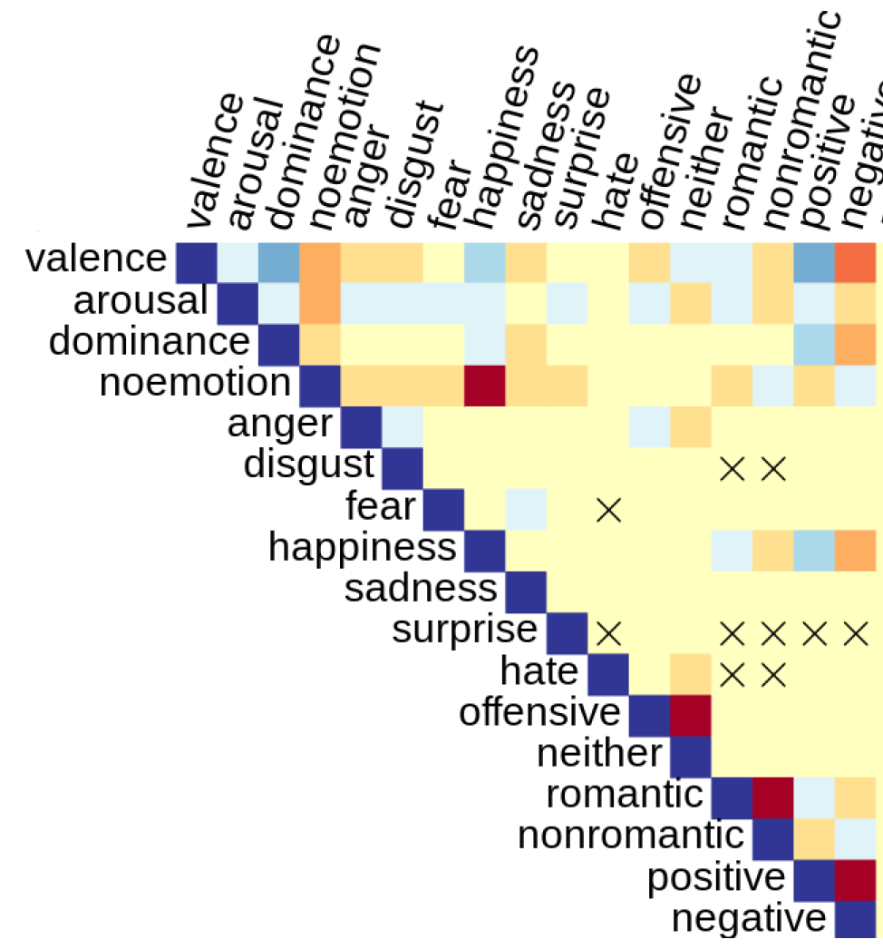
Conclusion & Future Directions
Some lessons and future directions (continued)
Multiple styles co-vary together at the same time
Cross-style dependency
“xSLUE: A Benchmark for Cross-Style Language Understanding and Evaluation” (Kang & Hovy, preprint 19)
E.g., text written by doctorate degree is often non-humorous
Cross-style classification/transfer with shared representation across styles
E.g., Formality ↔ Politeness ↔ Gender

Slide 33
QA
Acknowledgements
This work would not have been possible without the ViST dataset and helpful suggestions with Ting-Hao Huang. We also thank Alan W Black, Dan Jurafsky, Wei Xu, Taehee Jung, and anonymous reviewers for their helpful comments.
Dongyeop Kang
dongyeok@cs.cmu.edu
Code & Dataset
github.com/dykang/PASTEL

Slide 34
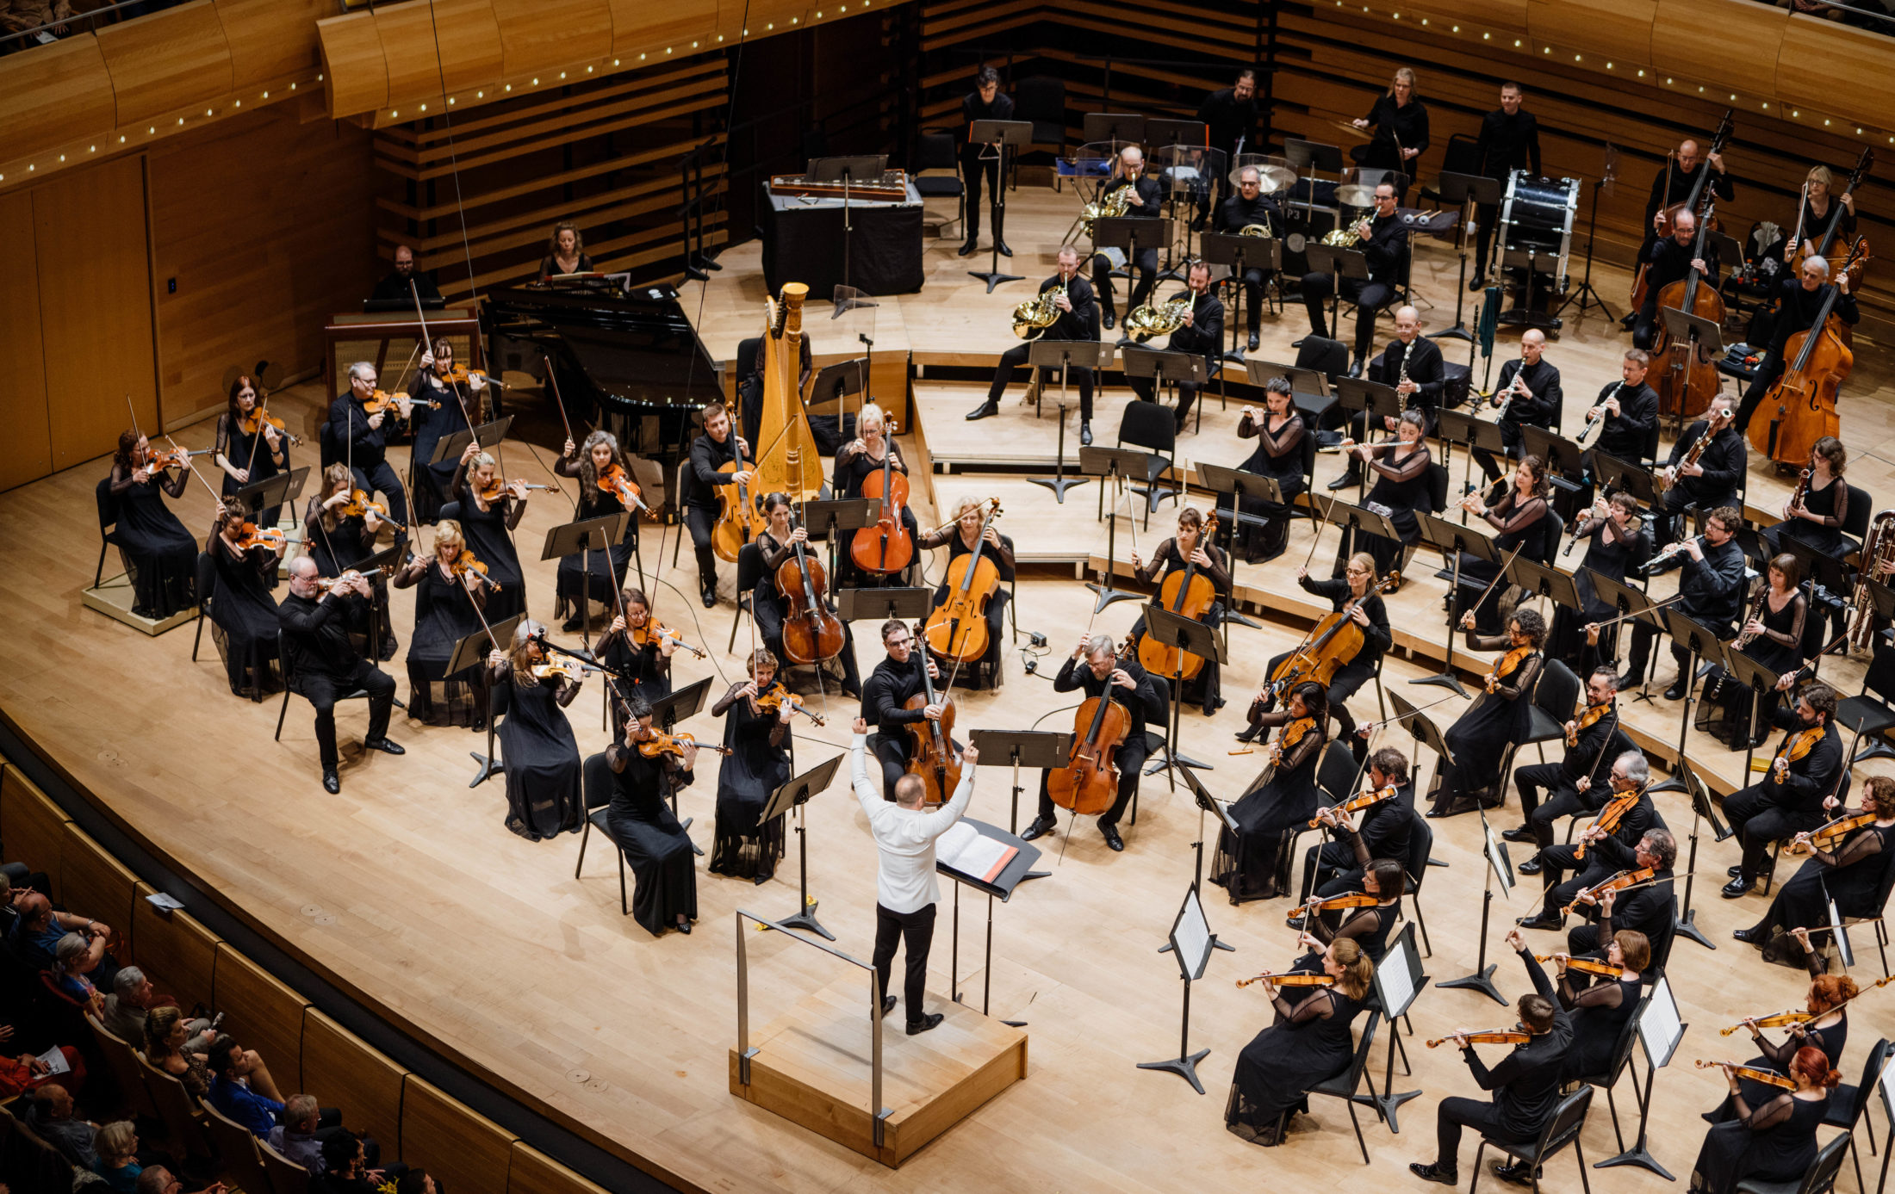

Slide 35
Applications in Style Language
Stylometry
Authorship attribution & author profiling & attribute classification (Koppel et al., 11; Argamon et al., 09; Koppel & Winter, 14, Verhoeven & Daelemans, 14, Stamatatos et al., 18)
Style bias & biographic attributes (Vogel & Jurafsky, 12) (Garera & Yarowsky, 09)
Style transfer between text
on text written in parallel
Gender (Reddy & Knight, 16), Political view (Prabhumoye et al., 18), Sentiment (Fu et al., 18; Shen et al.,17; Hu et al., 17), Medium (Han et al., 17),
on pararalley written text
Medium (Jhamtani et al., 17), Sarcasm (Peled and Reichart, 17), Formality (Rao & Tetreault, 18)
Notes:
Stylometry: Stylometry is the application of the study of linguistic style, usually to written language, but it has successfully been applied to music^{[1]} and to fine-art paintings^{[2]} as well.^{[3]}
Stylometry is often used to attribute authorship to anonymous or disputed documents. It has legal as well as academic and literary applications, ranging from the question of the authorship of Shakespeare's works to forensic linguistics.
Compared to these, we aim to understand and demonstrate style variation owing to multiple demographic attributes.
However, none of the prior works have collected a stylistic language dataset to have multiple styles in conjunction, parallely annotated by a human. The multiple styles in conjunction in PASTEL enable an appropriate experiment setting for controlled style classification task

Slide 36
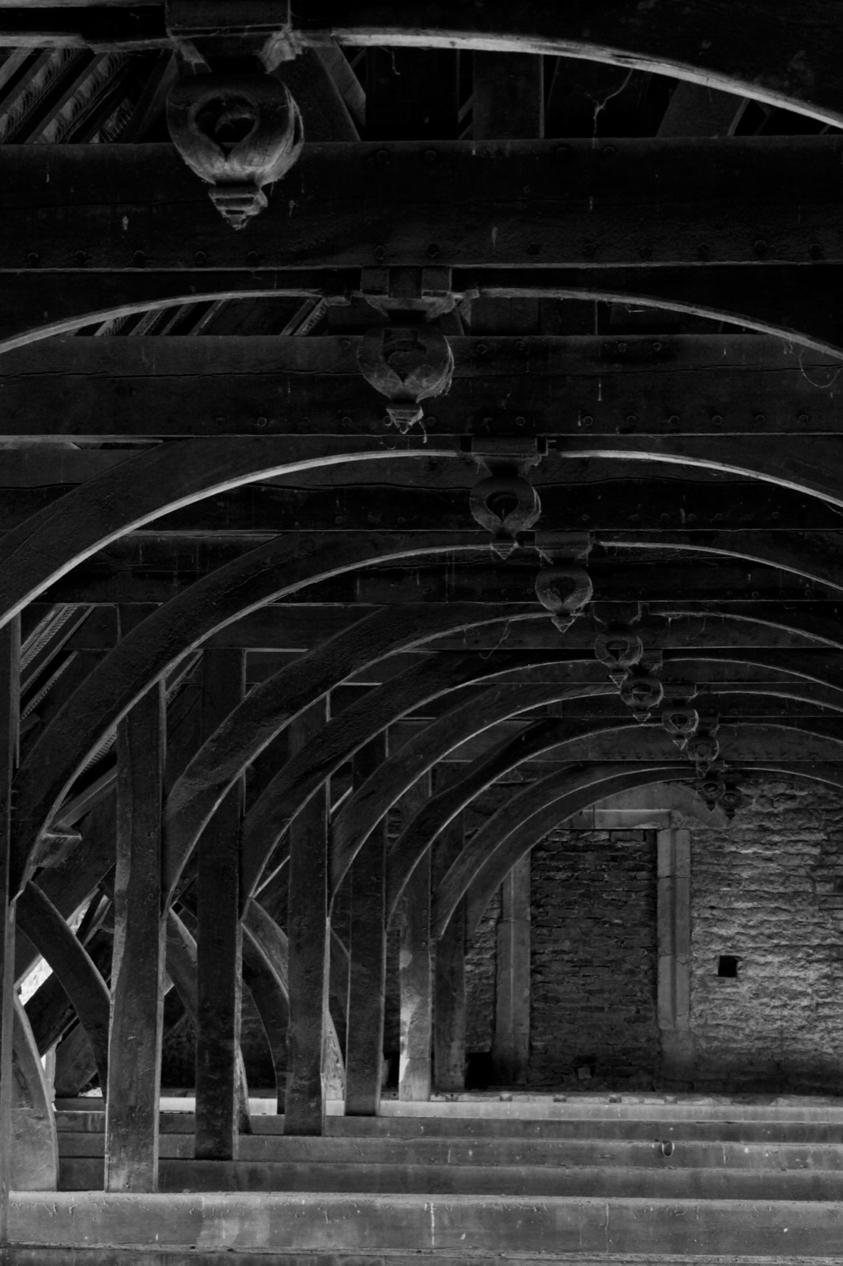
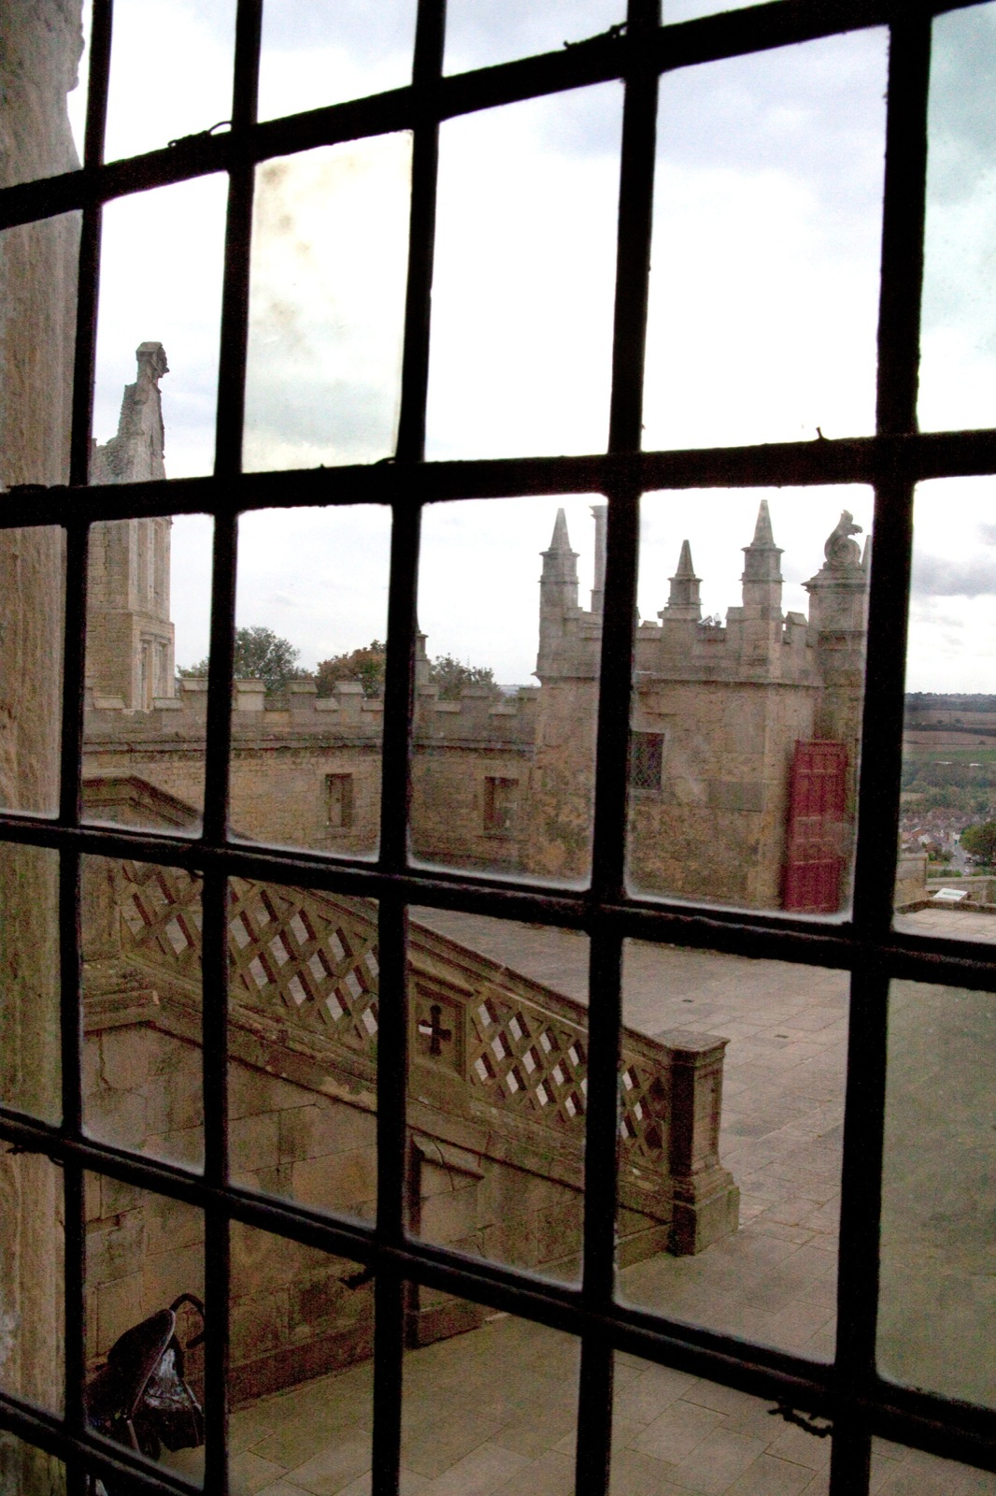
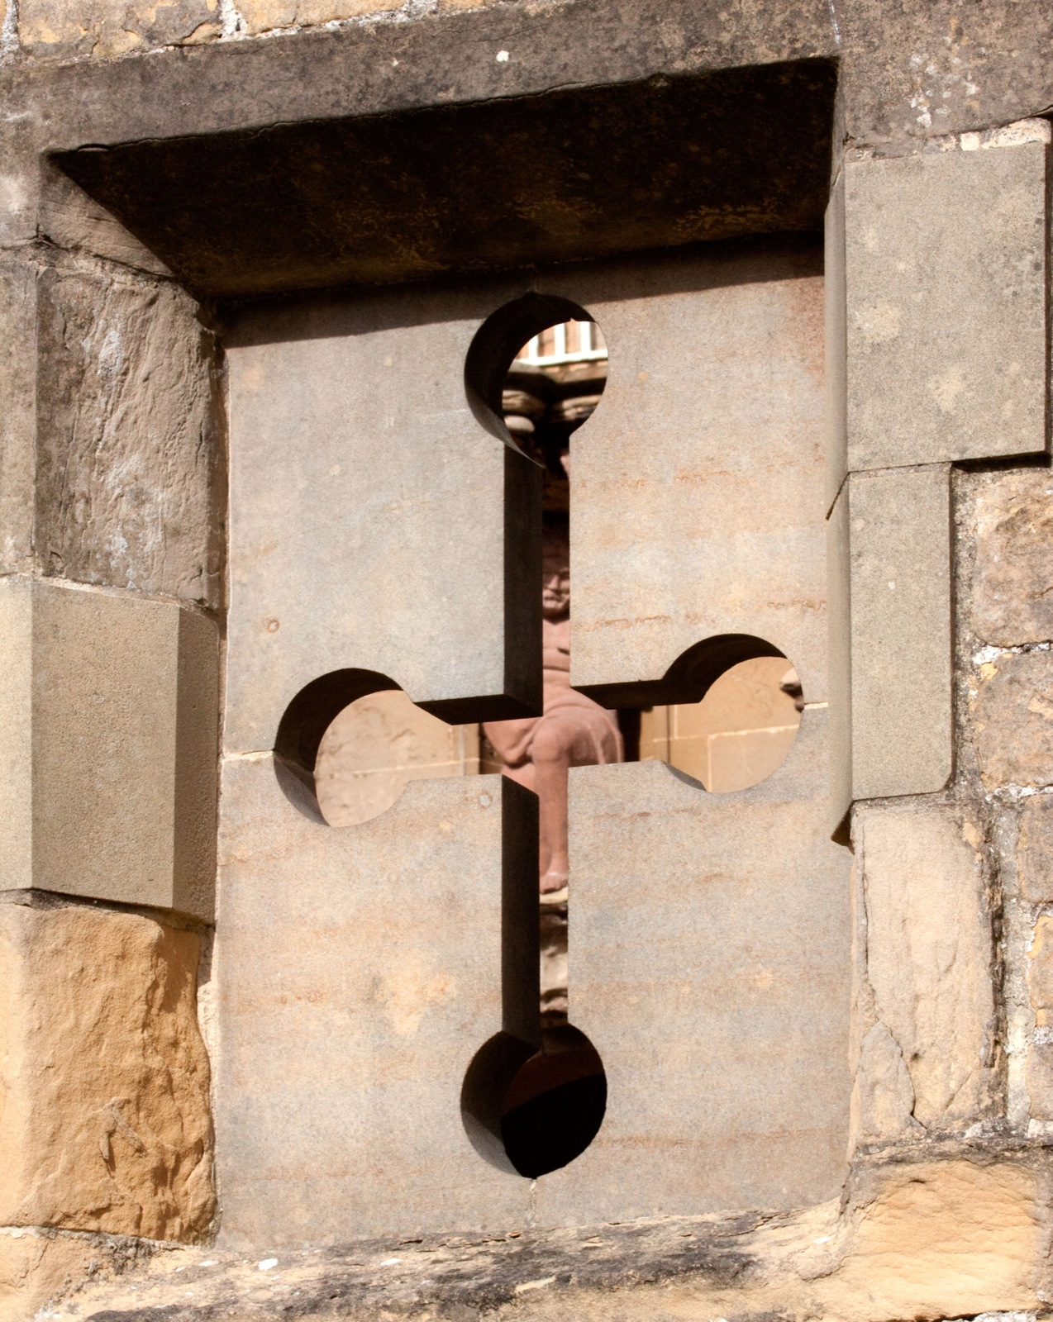
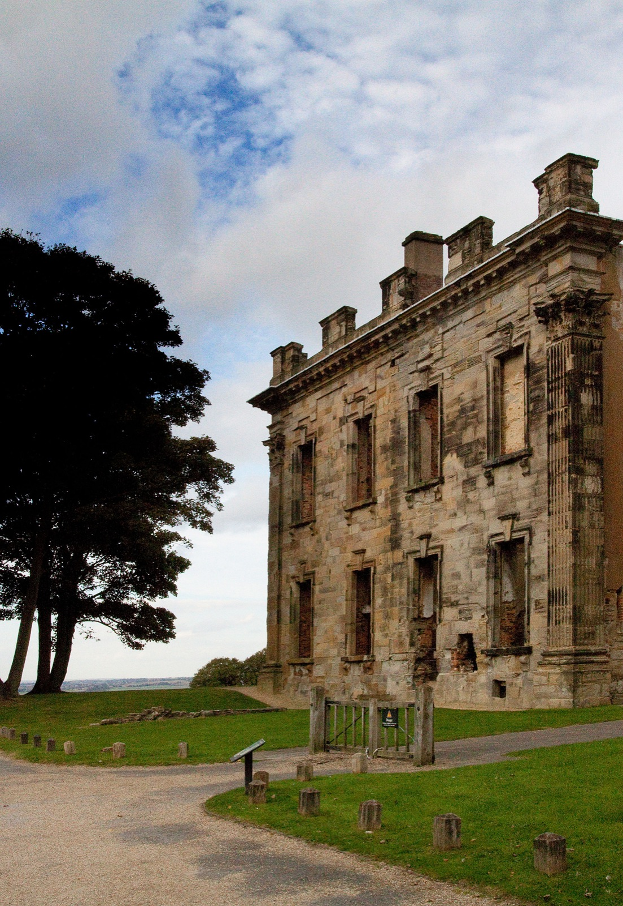
Which Denotation Setting?
Case study on denotation setting
vaulted, church, ceilings
windows, bars
slits, shape, cross
wooden, door, courtyard
visited, times, local, church
Story (Images
+ keywords)
Notes:
More context as a story and each has keywords

Slide 37
“Unsupervised” Style Transfer
Different ways to address the semantic drift
Male
Female
Latent Representation
Back-Translation
(Lample et al., 18, Prabhumoye et al,18)
CAE (Shen et al., 17)
Generator
Classifier
VAE-GAN (Hu et al., 18)
Notes:
Cross-aligned auto encoder
Di

Slide 38
“Supervised” Style Transfer
Semantics preserves between two parallel text because of the shared denotation
Male
Female
D1
...
...
...
Di
Encoder
Decoder
Seq2Seq (Bahdanau et al., 14)
Male
Female

Slide 39
Examples (sentence)
Denotation
(only text)
the living room of our new home is nice and bright with natural light.
Ex 1: The natural lightning made the apartment look quite nice for the upcoming tour .
NoDegree
Male
Ex 2: The house tour began in the living room which had a sufficient amount of natural lighting.
Graduate
Female

Slide 40
Examples (story)
Denotation
(only text)
Went to an art museum with a group of friends . We were looking for some artwork to purchase, as sometimes artist allow the sales of their items . There were pictures …..
Ex 1: My friends and I went to a art museum yesterday . There were lots of puchases and sales of items going on all day . I loved the way the glass sort of brightened ...
HighSchool
Male
Caucasian
Ex 2: I went to the museum with a bunch of friends . There was some cool art for sale . We spent a lot of time looking at the sculptures . ...
Bachelor
Female
Caucasian

Slide 41
“Unsupervised” Style Transfer
Different ways to address the semantic drift
Male
Female
Latent Representation
Back-Translation
(Lample et al., 18, Prabhumoye et al,18)
CAE (Shen et al., 17)
Generator
Classifier
VAE-GAN (Hu et al., 18)
Notes:
Cross-aligned auto encoder
Di

Slide 42
“Supervised” Style Transfer
semantic preserves between two styles of text because of the shared denotation
Male
Female
D1
...
...
...
Di
Encoder
Decoder
Seq2Seq (Bahdanau et al., 14)
Male
Female

Slide 43
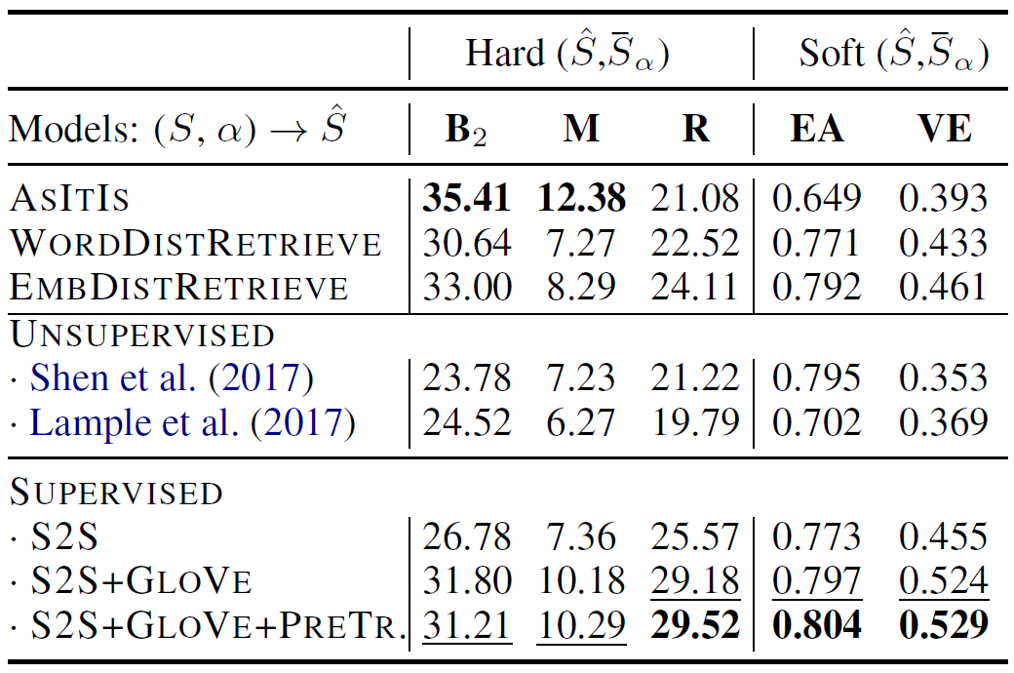

Slide 44
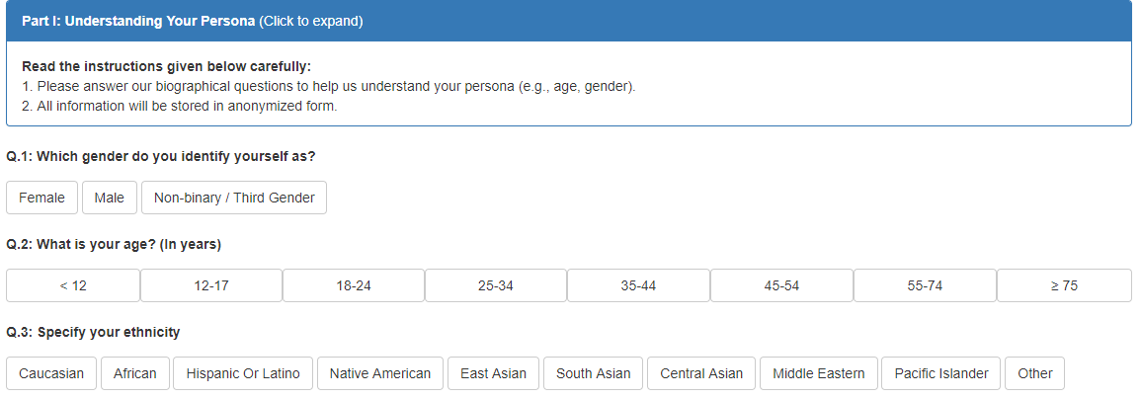
Annotation Schemes
(1) ask annotator’s demographic information
(2) given an input denotation, ask them to produce text about the denotation with their own style of persona
Notes:
To reflect annotators’ persona,
Stories from ViST dataset (Huang et al, 16)
we explicitly ask annotators to reflect their own persona in the stylistic writing, instead of pretending others’ persona.

Slide 45
Which Denotation Setting?
More quantitative experiment on denotation setting
Two trade-off measures
Meaning preservation :
Semantic similarity of the output with the reference
Metric: METEOR (Banerjee & Lavie, 05) and VectorExtrema (Liu et al., 16)
Style diversity :
How much outputs lexically differ amongst themselves
Metric: Gaussian-mixture entropy of N-grams
D
Notes:
Randomly chosen.
VecExtrama uising Glove
Word-overlap (hard metric) and embedding similarity (soft metric)
Variance of lexical diversity across annotators’ outputs given same denotation

Slide 46
Which Denotation Setting?
More quantitative analysis on denotation experiment
Provide a perceptually common denotation shared by annotators
with different levels :
sentence vs story (i.e., five sentences)
with different modalities:
sentence vs image vs image \w keywords
Input data:
Visual StoryTelling (ViST) dataset (Huang et al, 16)
Each sentence/story has a reference sentence
Keywords are extracted using RAKE (Rose et al, 10)
Notes:
Randomly chosen.
VecExtrama uising Glove

Slide 47


Explicit reflection of other styles in textual variation
G ( D , S) ➝ C
Style Transfer
Sentiment: Pos
Sentiment: Neg
C
= “ President Trump
visited S. Korea ….”
(Fu et al., 18; Shen et al., 17; Hu et al., 17)
D
Medium: News
Medium: Papers
S
= { Emotion: Anger,
Sentiment : Negative ,
Medium: News Articles ,
Relationship : Friends ,
Sarcasm: Sarcastic,
… }
(Han et al., 17)
Formality: Formal
Formality: Informal
D ➝ S
(Heylighen & Dewaele, 99; Rao & Tetreault, 18)
…
Notes:
Explciit: Depending on the topic, your styles are different: (I hate X, my emotion+sentiment will be more negative) (I talk to prof/friend/child, your langauge will be different)
It’s impossible to define them all… too many parameters.

Slide 48
Explicit reflection of other styles
Case study on style transfer
G_{P} ( D, S ) ➝ C
Positive
Negative
(Fu et al., 18; Shen et al., 17; Hu et al., 17)
C
= “ Hong Kong is ….”
News
Papers
D
(Han et al., 17)
S
= { Sentiment : Negative ,
Medium: News ,
Relationship : Friends , … }
Formal
Informal
(Heylighen & Dewaele, 99; Rao & Tetreault, 18)
…
Notes:
Explicit -> S related to context (denotation)
Explciit: Depending on the topic, your styles are different: (I hate X, my emotion+sentiment will be more negative) (I talk to prof/friend/child, your langauge will be different)
It’s impossible to define them all… too many parameters.

Slide 50
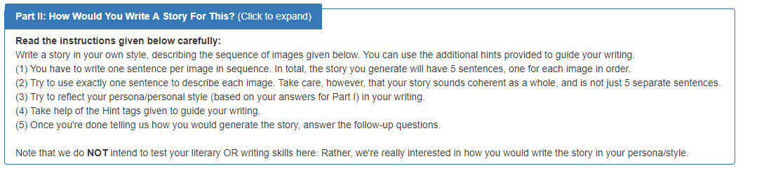
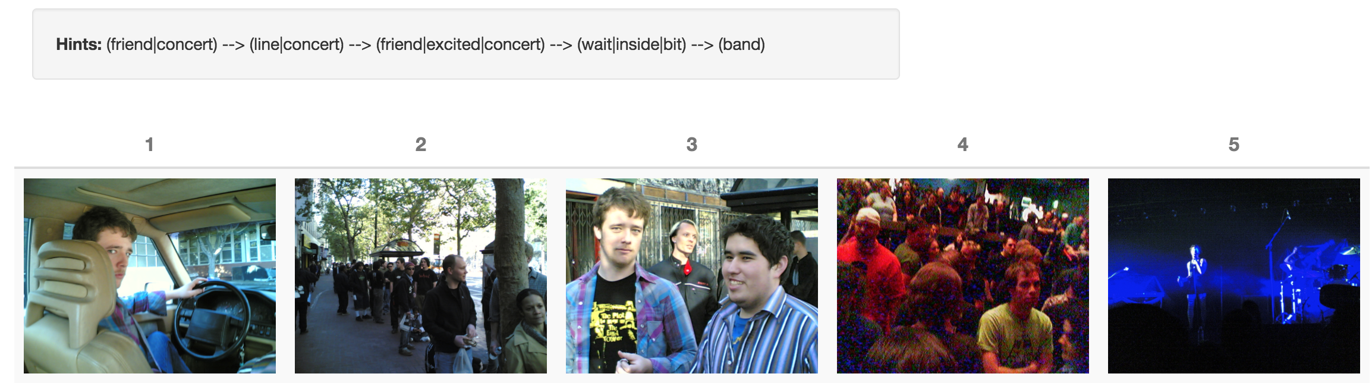

Slide 51
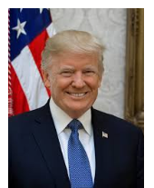
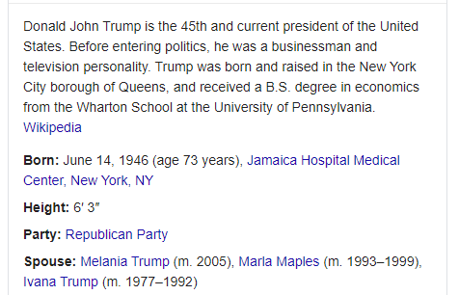



Types of Denotation
Icon: direct representation
E.g., Image or dictionary definition
Index: representation by association
E.g., Group characteristic, stereotype
Symbol: representation by convention
E.g., symbols/logos of companies
Philosopher C.S. Peirce (1839-1914)

Slide 52
Implicit reflection of persona styles
Case study on style transfer
G_{P} ( D ) ➝ C
Male
Female
C
= “ Hong Kong is ….”
D
LeftWing
RightWing
P
= { Gender : Male ,
Age : 25-34 ,
Political view : Left ,
Education : Ph.D. , … }
Notes:
Some people or many papers call the individual persona as “style”
Regardless of D, just collect many C1 given the specific target style value fixed.

Slide 53
Fix Denotation, Parallel Connotations
Case study on denotation input type
the old wooden door was only one way into the courtyard.
visited, times, local, church
slits, shape, cross
wooden, door, courtyard
Story (Images)
windows, bars
Text
Story (Images + keywords)
The old door with wood was the only direction to the courtyard
The old wooden door in the stonewall looks like a portal to a fairy tale.
Equally so, he is intrigued by the heavy wooden door in the courtyard.
Other settings (e.g., single Image, Story(Images)+Keywords) are also tested
Each annotator has different persona though

